Slide 1
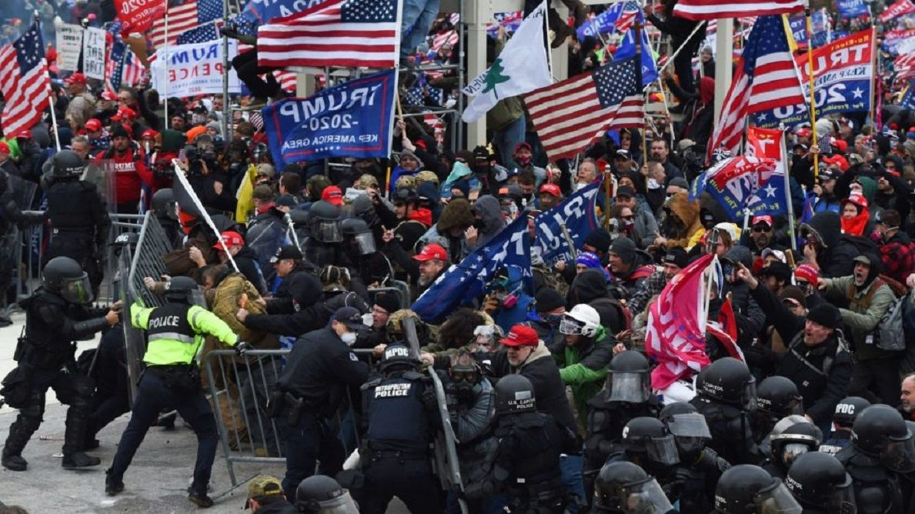
What’s True About Jan 6th? Professor David Michael Boje

Slide 2
Jan 6th There-Being (DaSein)

Slide 3
Enthinkment.com
Does the essence-question deprive all thinking of breath?
Does it bring to light the groundlessness of all philosophy?
Does essence of truth question disregard actual existence?
Strong common sense asserts its own right to an appeal to obviousness

Slide 4
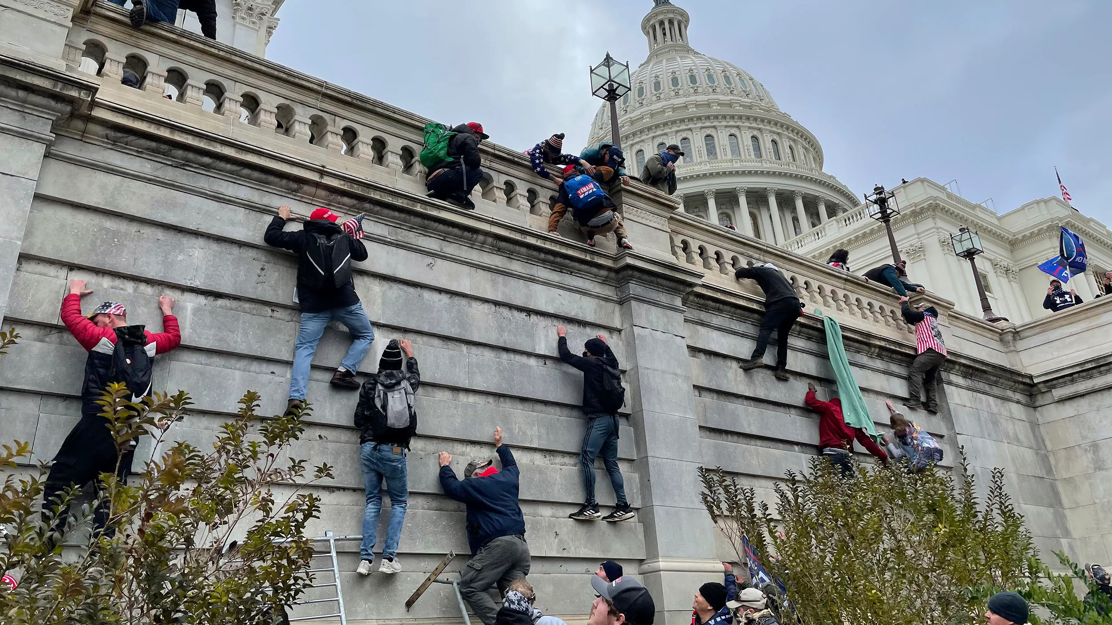
Capital Assault

Slide 5
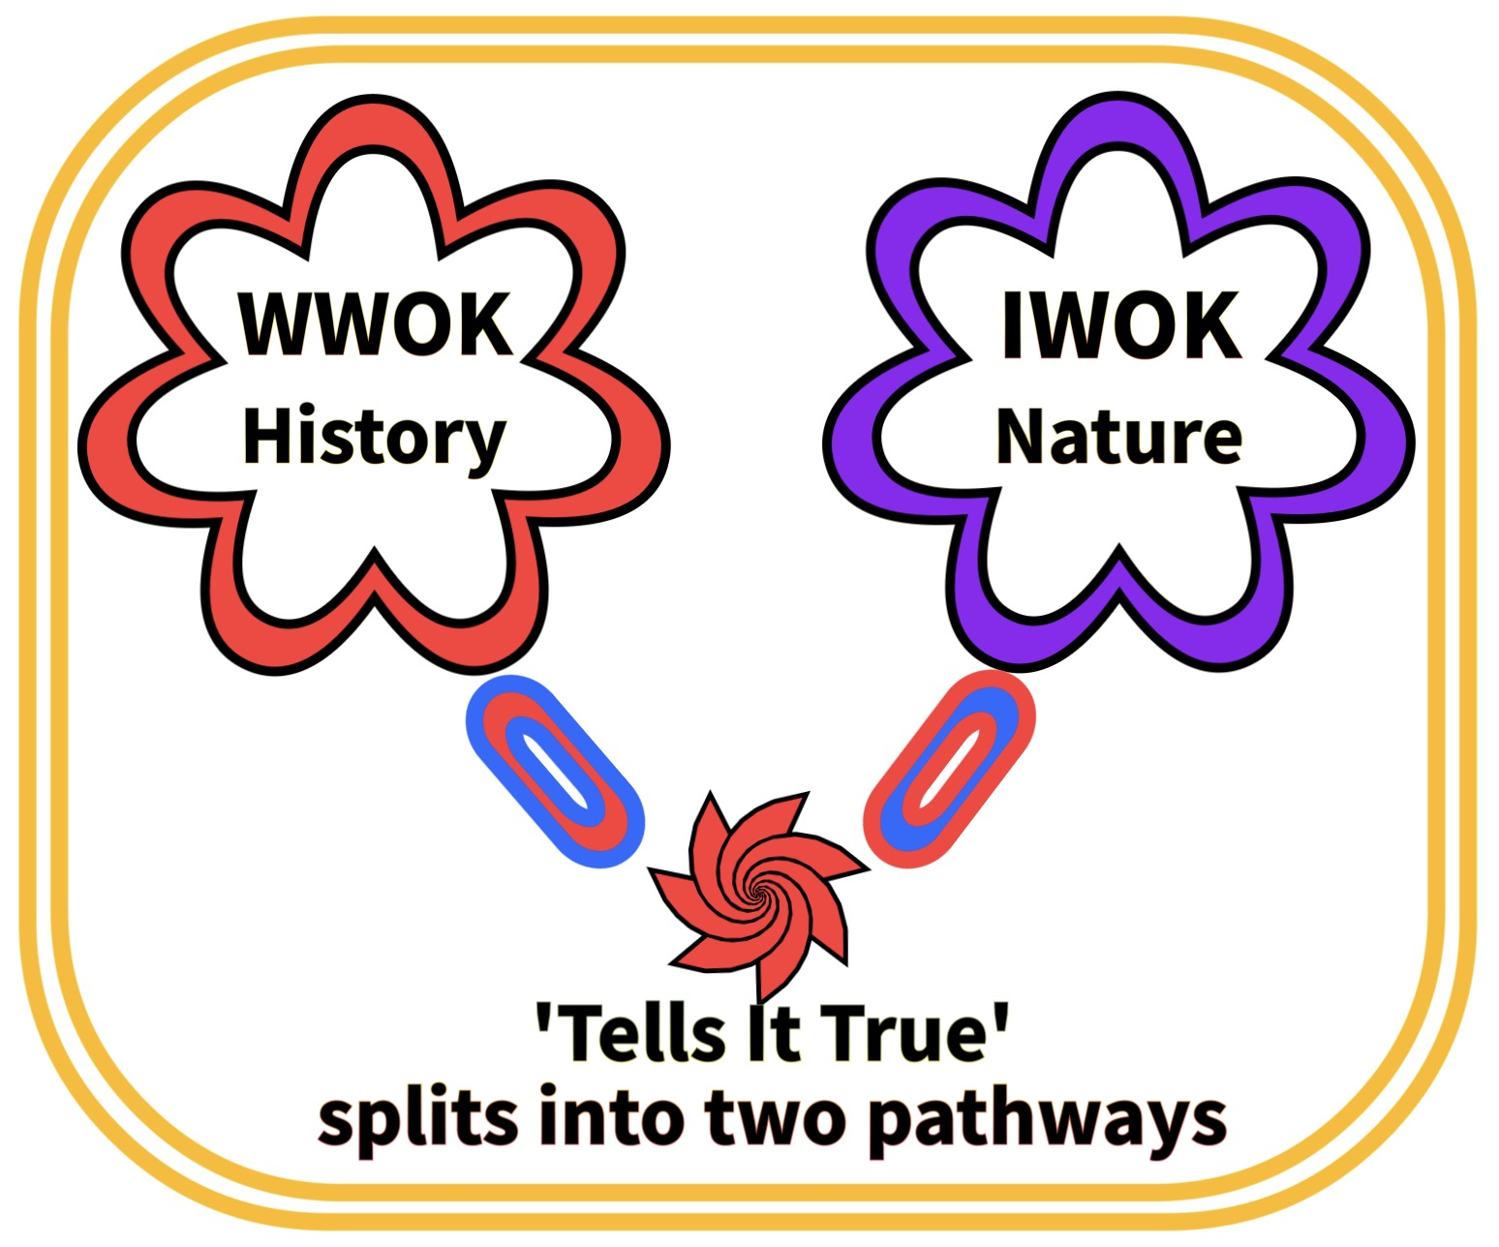
WWOK – Western Ways of Knowing IWOK – Indigenous Ways of knowing TellsitTrue.com

Slide 6
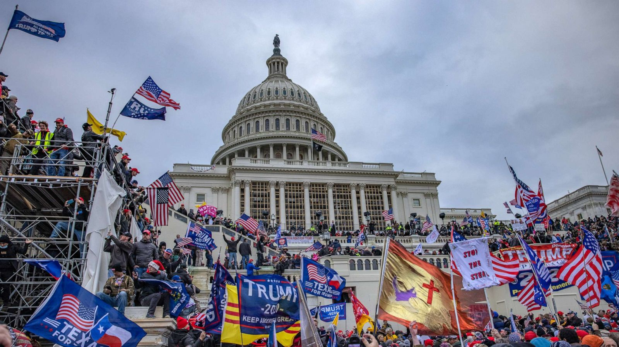
Insurrection

Slide 7
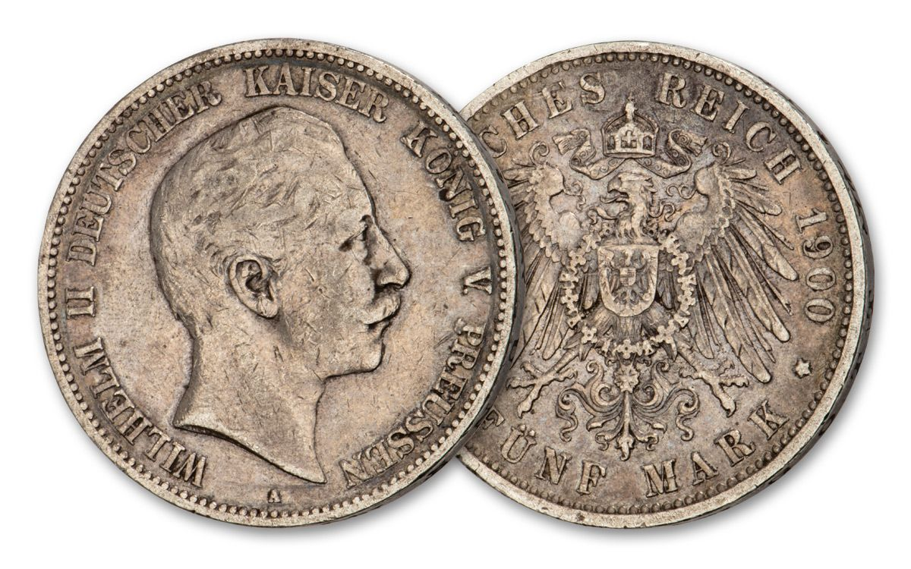
Two 5-Mark Silver Coins

Slide 8
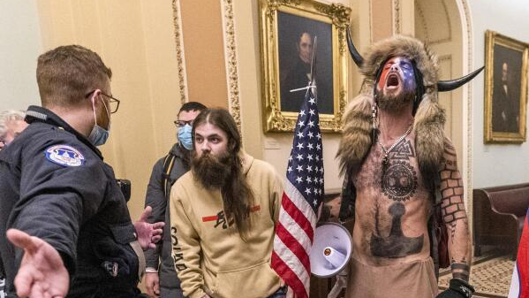
Insurrectionists

Slide 9
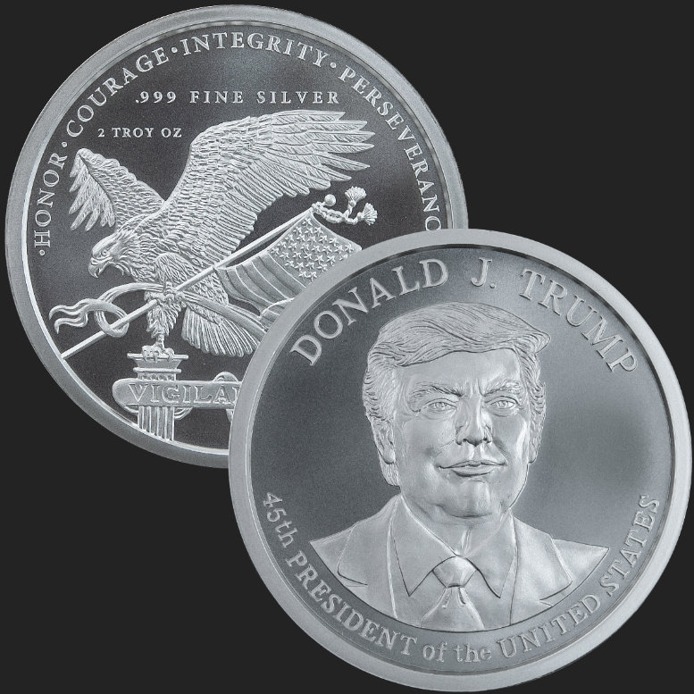
2 Trump Silver Coins

Slide 10
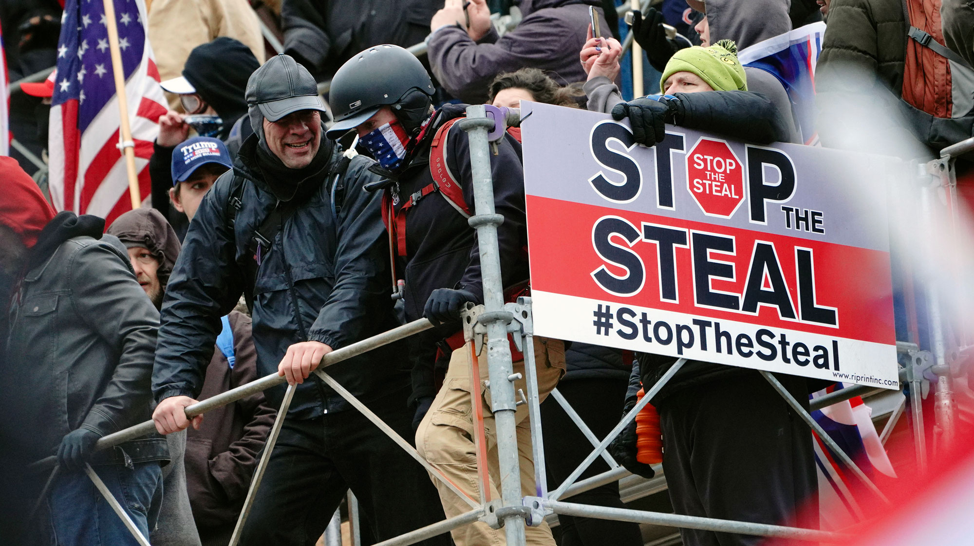
Rebellion

Slide 11
On the Essence of Truth – Martin Heidegger
Not truth of practical experience
Not turth of economic calculation
Not truth of technical consideration
Not truth of political sagacity
Not truth of thoughtful reflection
Not Truth of cultic belief
The Question: What is the essence of truth?

Slide 12
MAGA

Slide 13
Where do we stand today at Enthinkment Circle on the Essence of Truth?

Slide 14
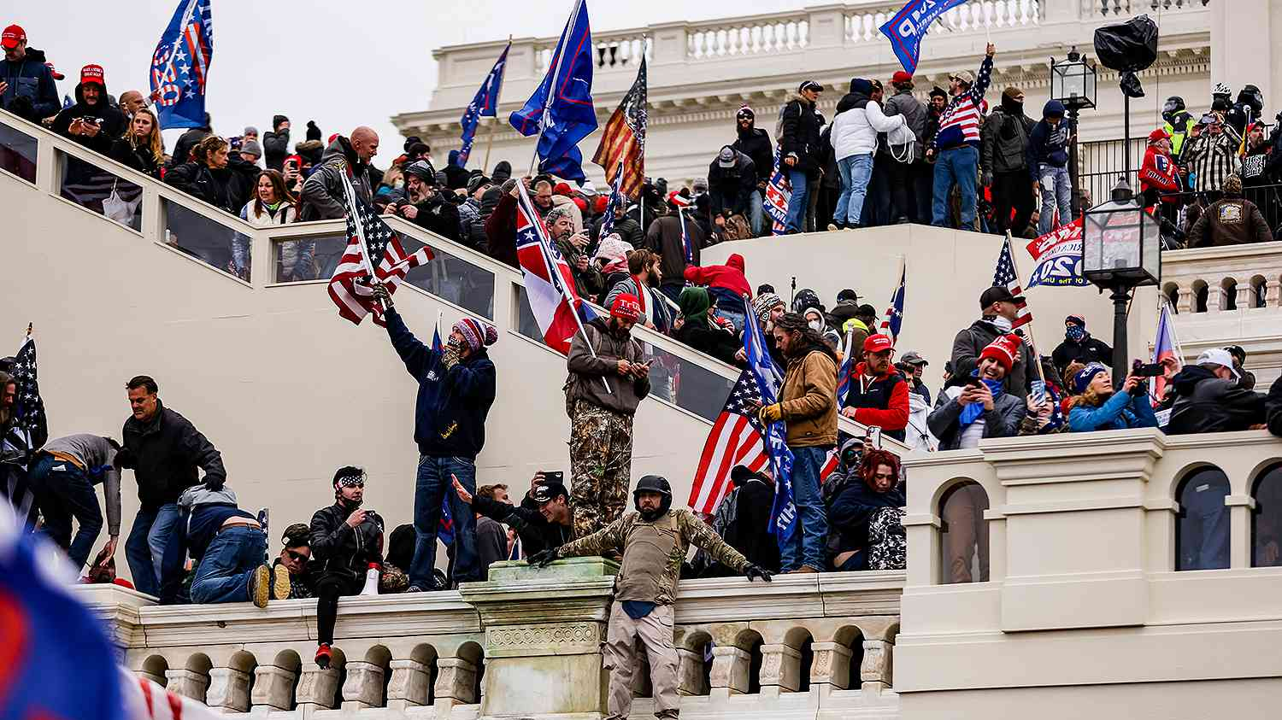
Is Truth Correspondence (Angeleichung)? In Accord with Matter [or] Knowledge?

Slide 15
Divine Right to Lead Bestowed by God
Intellectus Divinus --> Intellectus Humanus by Divine Plan of Creation guarantees Veritas
Accord agreement of world order of creation, taken as proposition of logical (logos) truth
Question: Is Divinus Correspondence & Correctness having lack of success in USA?
“Veritas est adaequatio intellectus et rei” is a Latin phrase that translates to "Truth is the adequation of things and intellect"

Slide 16
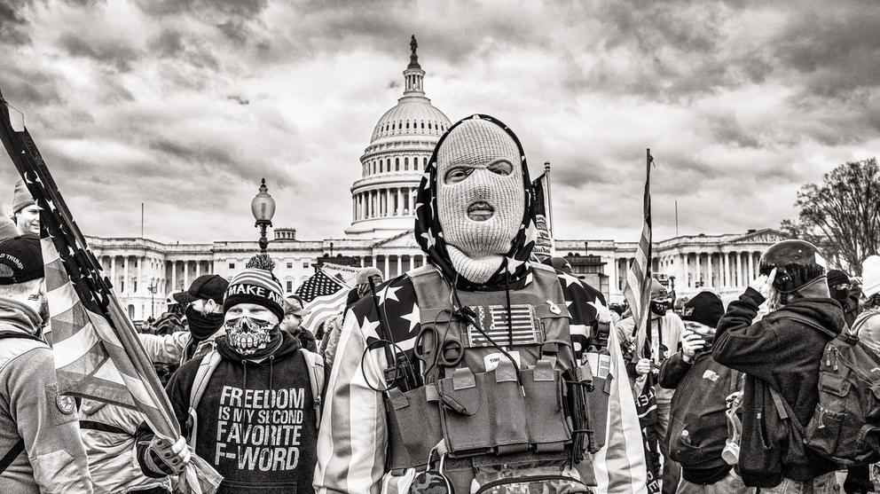
Freedom is the F-Word

Slide 17
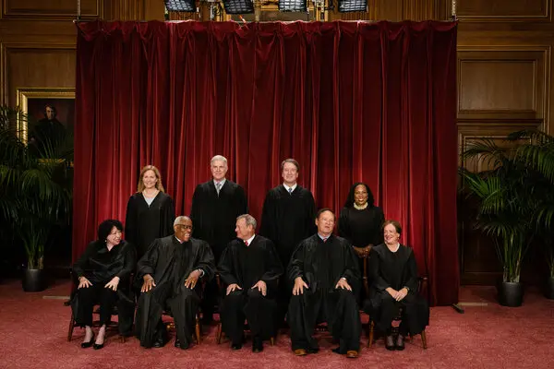
Is there (Presidential) Comportment of Leadership, Conforming to ‘pregiven’ fulfillment of ‘essence of truth’?
Supreme Court opened up the open region as ‘Essence of Freedom” of presidential leadership, an “openness of comportment” must be assessed by District Court
Is this Human Caprice?
Is it Sound or Unsound Judgment?
Deceit, dissimulation, lies & deception, illusion and semblance of all kinds of Untruth (Heidegger Section 3).

Slide 18
Supreme Court Ruling – Presidential Immunity

Slide 19
The Essence of Freedom
Is Enthinkment Circle prepared for a transformation of thinking.
Correctness between Truth and Freedom and experience of the Concealed Truth
Essential Ground of [Da-Sein=Man] (section 4) reappears in the Domain of Truth, as inner possibility of correctness of more Original essential truth
Freedom opened-up into an open region
187 minutes Turmp letting the insurrection be (ek-sistent), as it was planned.
To let be (Ta Alethea) is unconceals as unconcealment
Sein0Being (there-Being), Da-There

Slide 20
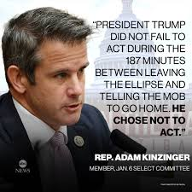

Slide 22
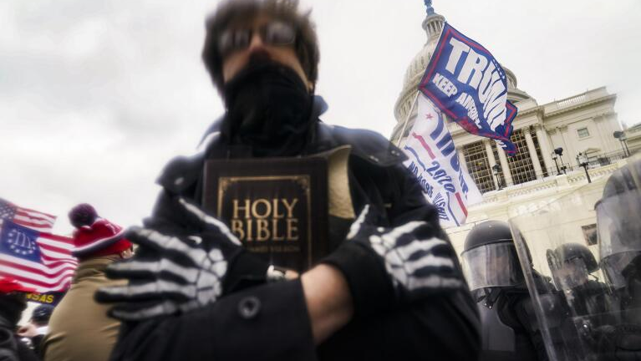
WWOK and Truth of the Bible

Slide 23
… ek-sistent, disclosive letting beings be, attuned to Freedom
Every mode of open comportment flourishes in letting beings be and in each case is a comportment to this or that being (Section 5).
Question: Has freedom has already attuned all comportment to being as a whole?
‘freedom has already attuned all comportment to being as a whole Being attuned, i. e., ek-sistent exposedness to beings as a whole, can be “experienced" and “felt” only because the “man who "experiences” without being aware of the essence of the attunement, is always engaged in being attuned in a way that discloses beings as a whole” (section 5).

Slide 24
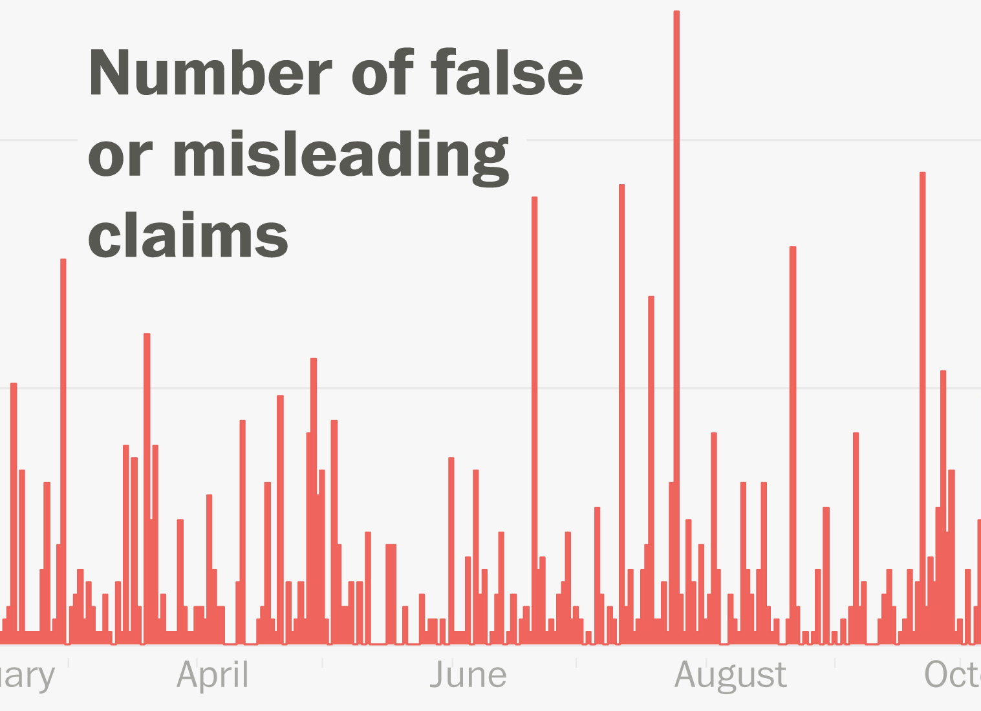
Trump does not merely stray into errancy. He is always astray in errancy (Section 7)

Slide 25
Antenarrative & articulation of the truth of being as a whole
WWOK Storytelling = history
How many have ears for these words matters not.
Who those are that can hear them determines man’s standpoint in history (section 8)

Slide 26
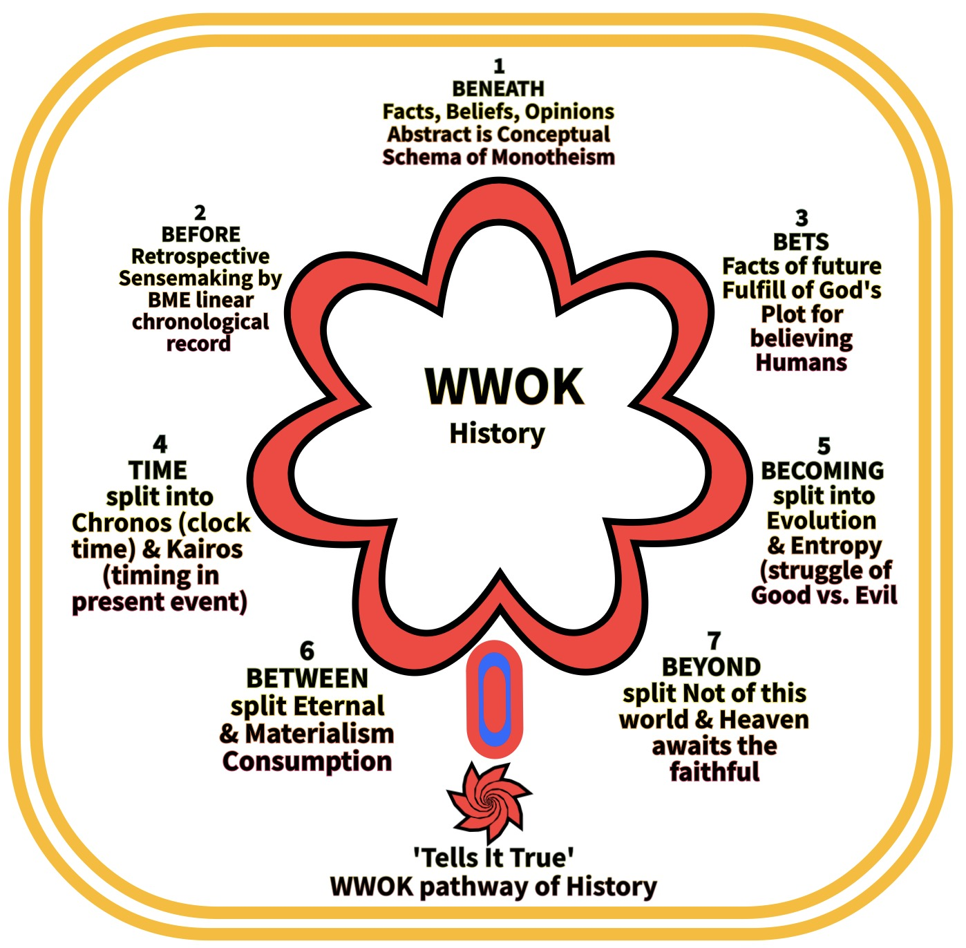

Slide 27
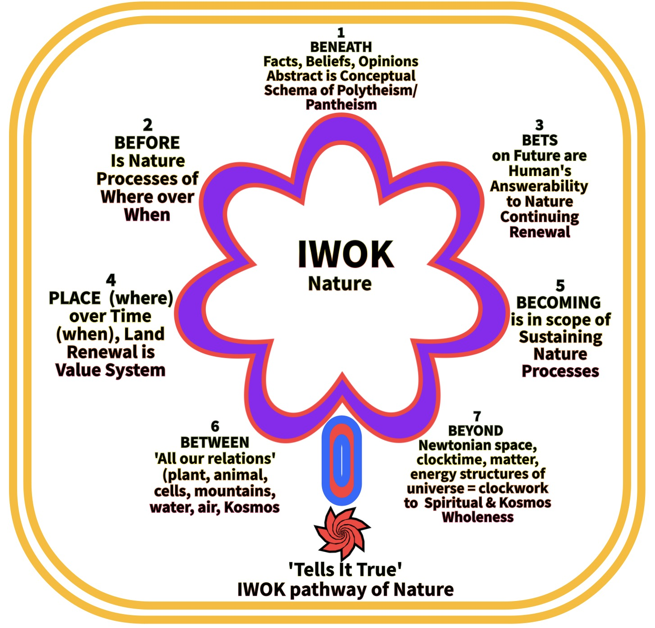

Slide 28
Braided River

Slide 29
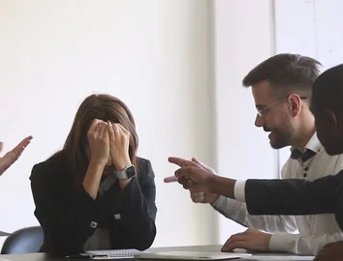
WHY WE Can't Have Conversation Anymore?
David Michael Boje
Enthinkment.com
Tellsittrue.com
Quantum-storytelling.com
TrueStorytelling.org

Slide 30
More info
Annual December Quantum Storytelling Conference –
Quantum-Storytelling.com
Tellsittrue.com
TrueSTORYTELLING.org
davidboje@gmail.com
Antenarrative.com

