Slide 1
Introduction to CHORA WAYS OF KNOWING CWOK and Antenarrative Processes
Gerri McCulloh and David Michael Boje

Slide 2
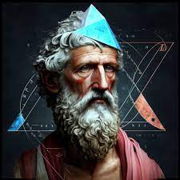
Pythagoras
Pythagoras of Samos (570 to approx. 500 BCE) was an ancient Ionian Greek philosopher, polymath and the eponymous founder of Pythagoreanism.
The Ionians were one of the four major tribes that the Greek
His political and religious teachings were well known in Magna Graecia and influenced the philosophies of Plato, Aristotle

Slide 3
Source Material:
TOWARD AN ACOUSTIC RHETORIC: VITAL MATERIALISM’S DIFFRACTIONS
BY GERRI ELISE MCCULLOH, B.A., M.A.
A dissertation submitted to the Graduate School in partial fulfillment of the requirements for the degree
Doctor of Philosophy
Major Subject: Rhetoric and Professional Communication
Minor Subject: Business Management
New Mexico State University
Las Cruces, New Mexico
November 2015
Copyright 2015 by Gerri Elise McCulloh

Slide 4
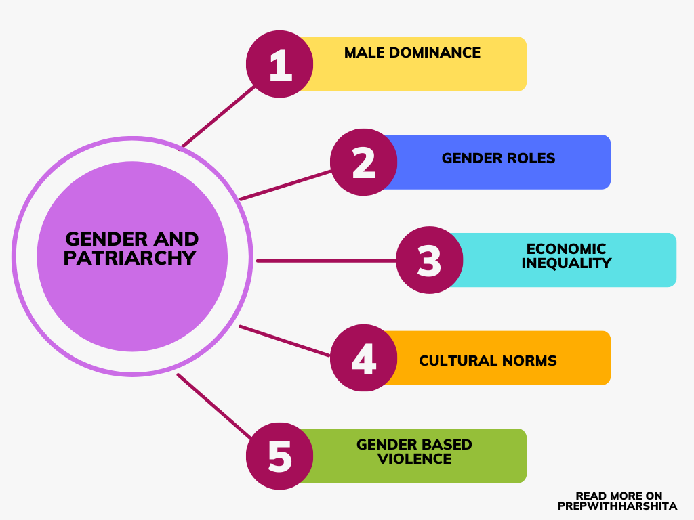
What happened from Pythagoras to today?
1000 to 500 BCE 3000 the move from matriarchy to patriarchy occurred. Note: The concepts of matriarchy and patriarchy are European ways of thinking about societal power

Slide 5
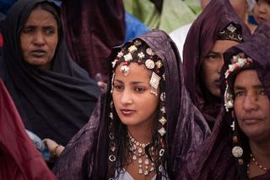
What happened from Pythagoras to today?
570 to approx. 500 BCE Pythagoras lived and emphasized Kairotic time (acoustic vibrant materiality; acoustic fields of music, Kosmos harmonics). Pythagoras lived at end of an era still holding women equal to men (matriarchy & patriotism). Aion (Greek: Αἰών), a Hellenistic deity associated with perpetual, unbounded, ritual, and cyclic-time, the orb or circle encompassing the universe, and the zodiac. The future is a returning version of the past, later called aevum, and Vedic Sanskrit.
15th & 16th century. Genocide of indigenous populations around the world primarily occurred during the period of European colonization, starting with Christopher Columbus' arrival in the Americas in 1492, leading to a massive decline in indigenous populations & Indigenous Ways of Knowing (IWOK) across the globe, due to violence, disease, and displacement.,
Tuareg are Berber people practicing matrilinear customs, living a nomadic lifestyle in the Saharan dessert (more examples).

Slide 6
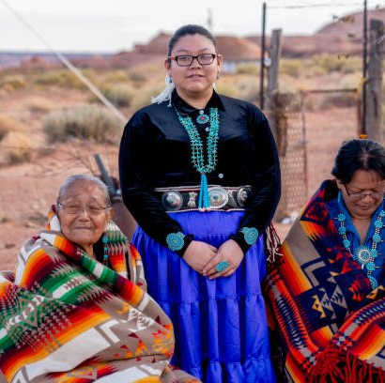
What happened from Pythagoras to today?
17th & 18th centuries Age of Enlightenment, Newtonian Physics ‘Principia in 1687 (time becomes clockworks, clocktime), Age Reason, as we call it: ‘Western Ways of Knowing (WWOK)’, acted to drastically reduce Kairos to Chronos (linear, one-way, chronological time) and Aion time (perpetual cyclical and ritual). Example Newtonian clocktime, cosmos as clockwork.
19th century continued decline of Ways of Knowing (IWOK) as WWOK gained more and more dominance, worldwide. Kairos time is reduced to just ‘opportune moments’ losing its Pythagorean living vibrant materialism, and its acoustic fields. Some indigenous societies have a balance between men and women, with each gender having their own responsibilities, with colonization most became patriarchal.
Photo of Hopi - The Hopi (northeastern Arizona Rez.) are traditionally both matriarchal and matrilineal, with egalitarian roles in the community, and no sense of superiority or inferiority based on sex or gender.

Slide 7
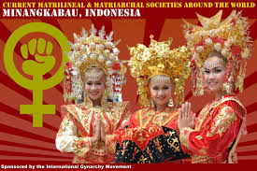
What happened from Pythagoras to today?
In 2007-2014, strands of vibrant materialist work take hold. Vibrant materialists believe that matter has vitality and life, even if it appears lifeless), but are less focused on Pythagorean acoustic harmonics. Examples: Karen Barad (intra-active material/discursive), Donna Haraway (material-semiotic), Jane Bennet (vibrant-matter), and Mira J. Hird (material feminism) rekindle vibrant materialist way of knowing.
2015, Gerri McCulloh revitalizes ‘Chora’way of knowing: (materially generative space-place) as a revival of Pythagorean Kairotic vital acoustic materialism and aligned with vibrant materialists works that destabilizes human-centric view in favor of humans no more important than millions of species inhabiting planet.
For McCulloh Chora is Pythagorean and can contribute ‘soundscapes’ to vital materialisms, and respect for the few remaining matriarchically-oriented. Today most societies are patriarchal.
The Minangkabau
This society is one of the largest surviving matriarchal societies, with women ruling the domestic realm and the belief that the mother is the most important person in society

Slide 8
What is Chora?
Chora as the generative place where vital material is energized and marked by dunamis or dynamis; this is an echo of matriarchal generativity… and renewal
“I will look at Chora as generative place that can be accessed through vital materialism’s diffractions: sound and acoustic sensibility” (McCulloh, 2015: 232).
Chora is understood acoustically through feminist materialism (IBID.).
“There is indeterminacy and contingency in naming. Chora as Pythagorean Thirding” (IBID).

Slide 9
What is Chora as Pythagorean Thirding?
“Agential separability, for Barad, is “exteriority within” and is therefore within a very different thirding of material-discourse [Karen Barad, Meeting the Universe Halfway: 377]” (McCulloh, 2015: 166).

Slide 10
7-sided Heptagon
Pythagoras treats 7 as acoustic field harmonics, tones of ‘acoustic materialism’ at his time when women held to be equal to men.
7 opposing ways of thinking about knowing
7 ways form tensions of 7 factorial relationships
Out of the 7 factorial comes something new.

Slide 11
Numeral 7 and Heptagon Spiral
“If one were to use perfectly equal angles to draw a heptagon, the result would be an open spiral. Heptagons must have at least one approximated angle to materialize, or they remain imaginary” (Mculloh, 2015: 95).
“…heptagonal spiral symbolized generative matter but not perfectly repeatable time; the number seven represented an aspect of a creatrix and the energy or creative harmony of kairos.
Kairos as the seventh moment in Pythagorean philosophy was uniquely open even as it merged conflicting, competing, or complementary logics. Harmonia, the other face of kairos in relation moving and merging tones, was feminine.
Kairos as the number seven was associated with inspiration and the kind of power that could change or overpower logos, becoming newly dynamic logos itself.
Sullivan theorized that kairos emerged from the subconscious parts of the mind as they were energized” (IBID. 96).

Slide 12
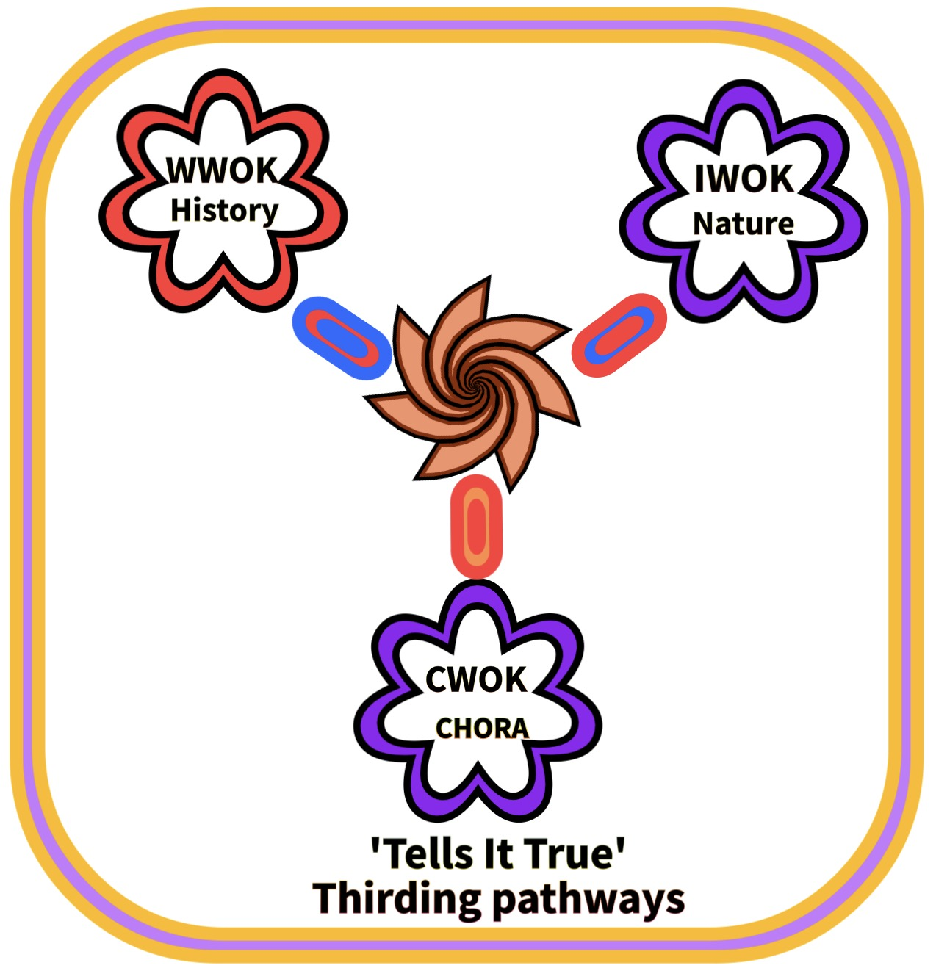
Thirding

Slide 13
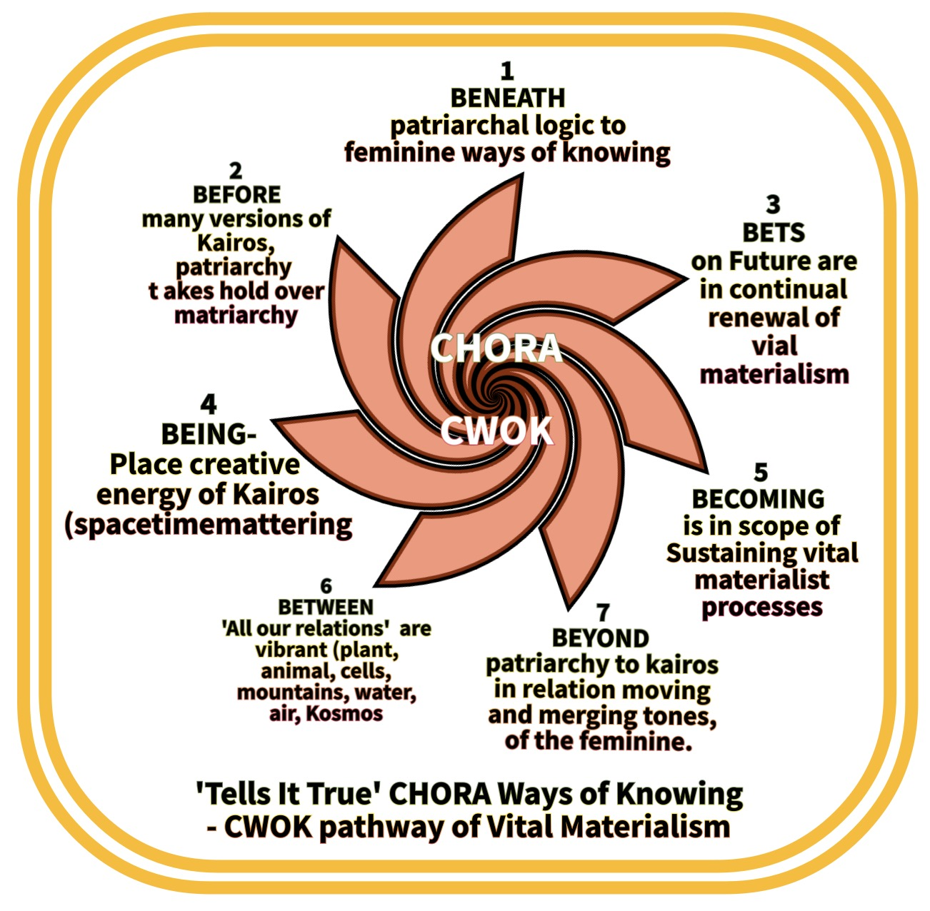
7 Antenarrative Processes as Chora Heptagon Spiral

Slide 14
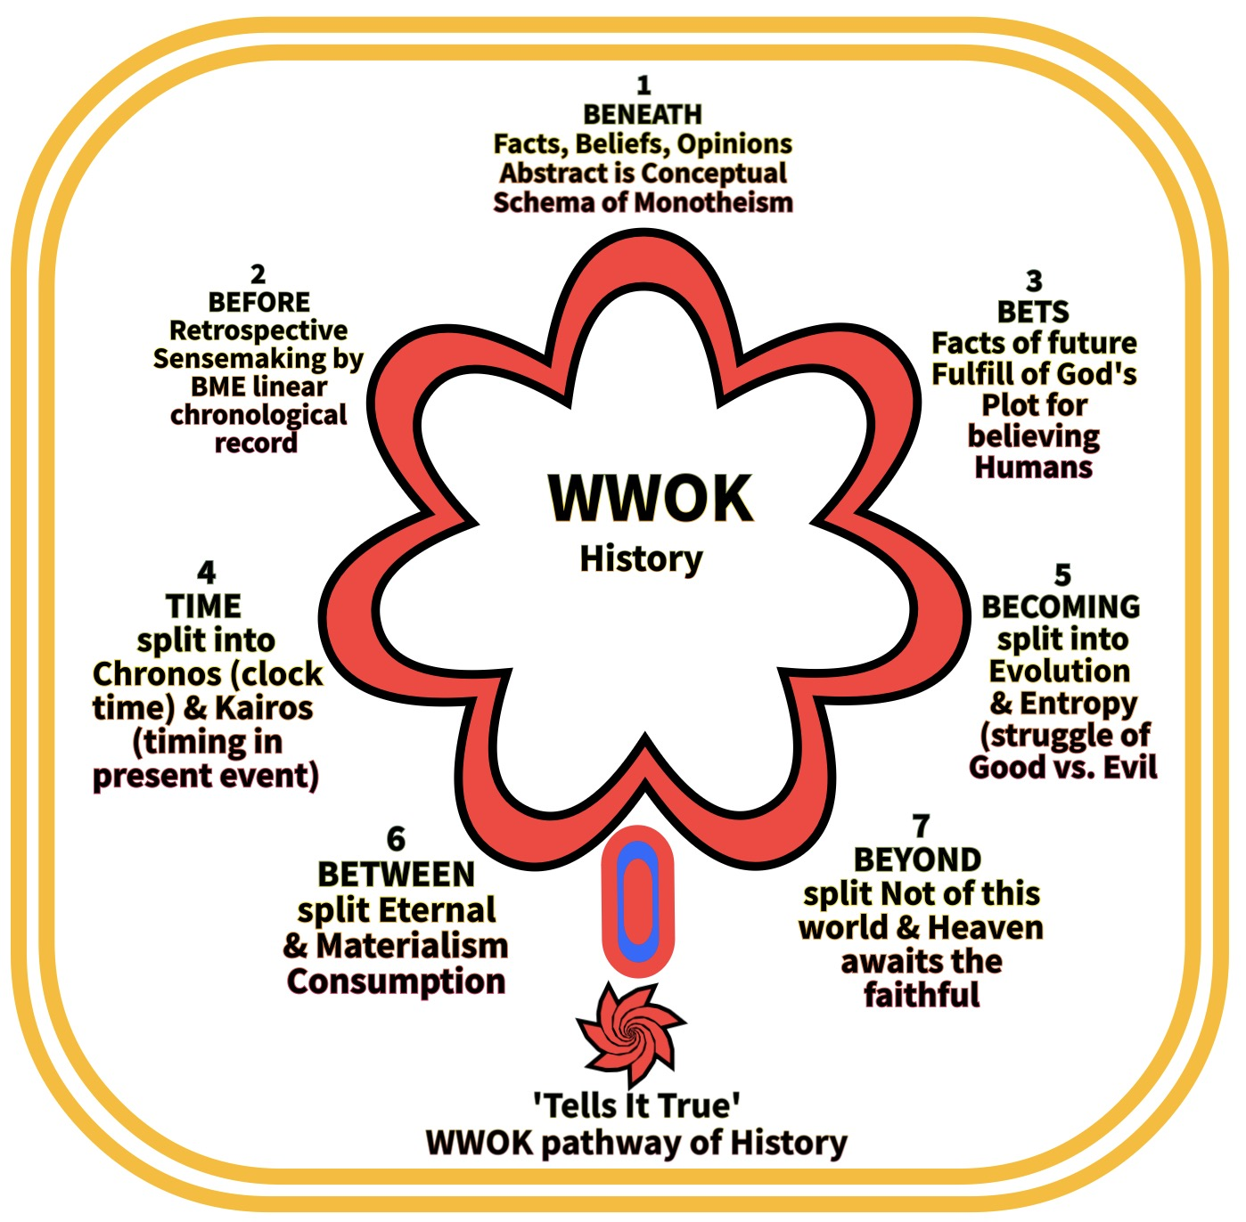
7 Antenarrative Processes as WWOK

Slide 15
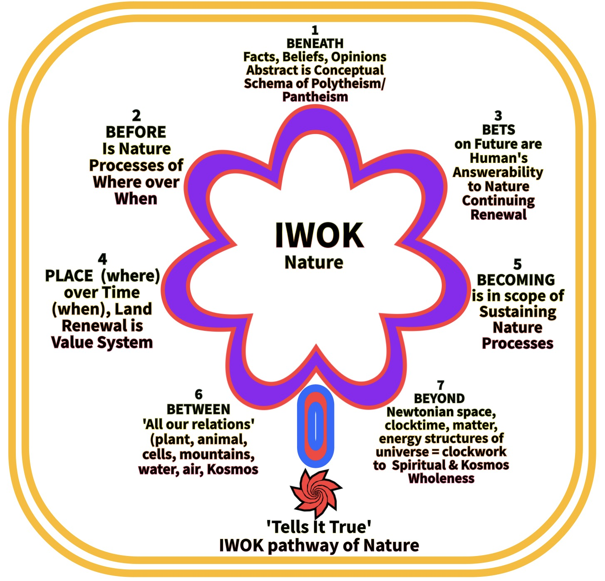
7 Antenarrative Processes as IWOK

Slide 16
Thirding

Slide 17
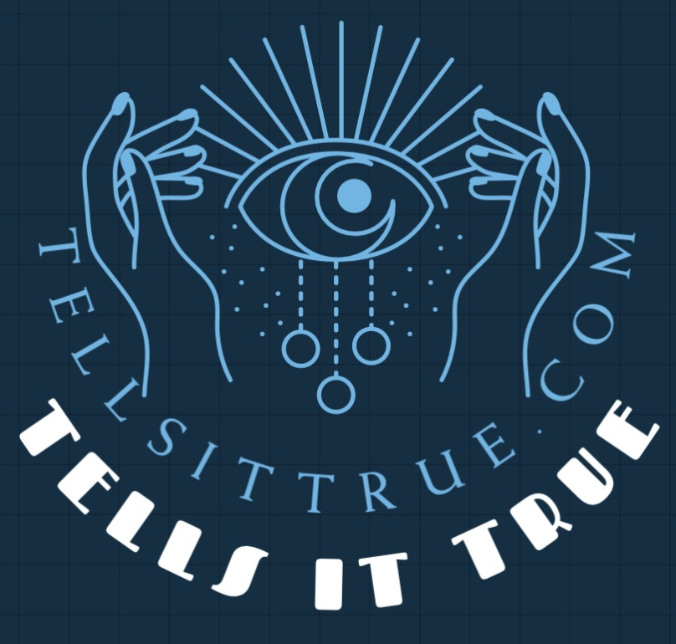
More info
Annual December Quantum Storytelling Conference –
Quantum-Storytelling.com
Tellsittrue.com
TrueSTORYTELLING.org
davidboje@gmail.com
Antenarrative.com

