Slide 1
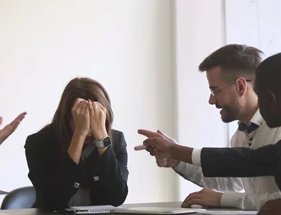
WHY WE Can't Have Conversation Anymore?
David Michael Boje
Enthinkment.com
Tellsittrue.com
Quantum-storytelling.com
TrueStorytelling.org

Slide 2
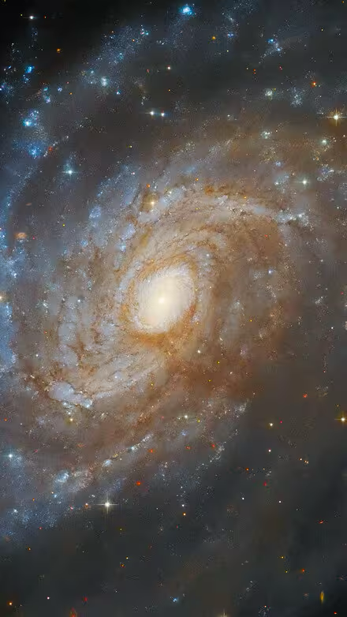
Outline
There are 2 Tells-It-True: WWOK & IWOK, what do we do about it?
Time to Amend 7 Antenarrative Processes
Quantum Physics / Quantum Storytelling (contrasts)
Grace Ann Rosile Tribal Wisdom for Business Ethics
WWOK & IWOK Metaphysics
7 WWOK & IWOK Antenarrative Processes
Māori Braided River Approach to WWOK – IWOK rebalancing
Leroy Little Bear Blackfoot (IWOK) Metaphysics
Quantum Physics contrast with Native Science
Heidegger Introduction to Metaphysics – still WWOK
Vine Deloria American Indian(IWOK) Metaphysics
Key Summary Points of Overlap and Difference WWOK-IWOK Metaphysics
Can Maori Braided River Alternative work in USA, EUROPE, & elsewhere?

Slide 3
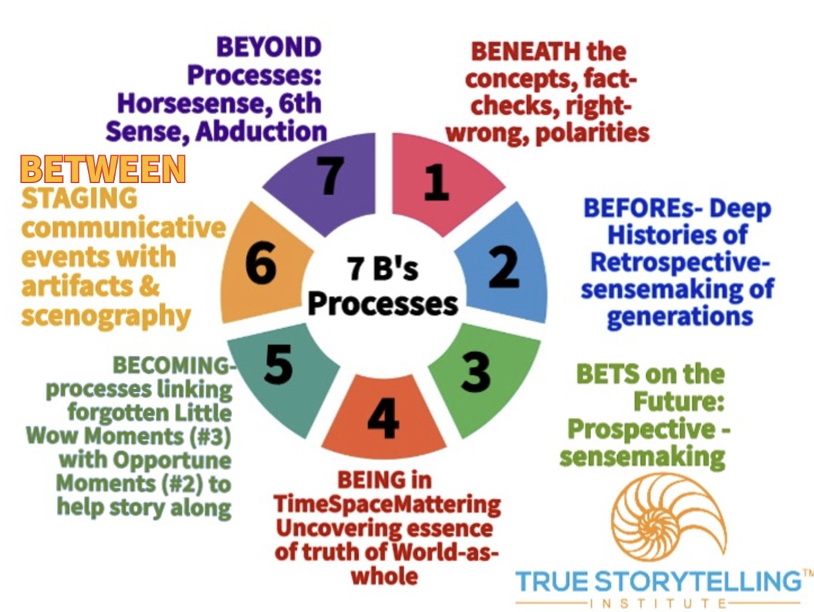
Time to Amend the 7 Antenarrative Processes Used in True Storytelling® because it’s too WWOK and we can do better

Slide 4
First Amendment: There are at least 2 ‘Tells It True’ in this world
WWOK (Western Ways of Knowing) & IWOK (Indigenous Ways of Knowing
More at https:/tellsittrue.com

Slide 5
Quantum Physics still WWOK & Quantum Storytelling Is Bringing IWOK Spirit & Nature Back In, not accepted
They overlap, but have key differences
 | Quantum Physics | Quantum Storytelling
Thinking | Left-brained | Wholistic
Energy Waves | Particle-wave duality | Energy waves are Spirit
Nature | Space/Time continuum | Imbued with Spirit
Relations | Everything is related | All by relations (animal, plant, water, air, mountains)
Continued Existence | Climate is changing | Needs constant renewal
Perspective | Reductionist | Wholistic
Language | Binary/math | Process
Wisdom | Experiment | 8 tribal values
Quantum-Storytelling.com

Slide 6
Tribal Wisdom
Necessary to decolonize Western Metaphysics (its ways of left-brain-thinking & individualism) & anthropocentrism, called Western Ways of Knowing (WWOK)
Indigenous Ways of Knowing (IWOK) metaphysics can’t be WWOK savior despite (its ways of right-brain, wholistic, & language of process-thinking), its Native Science (Cajete), focus on place-space-land (Deloria, Little Bear) and its non-anthropocentric perspective of humility

Slide 7
Tribal Wisdom
8 Aspects of Tribal Wisdom
As Rosile’s book points out there are key value difference between WWOK and IWOK, we can learn from IWOK some business ethics, but IWOK is too colonized to save WWOK
Relationships are an end in themselves
Gifting is valued more highly
Egalitarianism is preferred
Non-acquisitiveness is valued not greed
Usefulness or access to use is valued
Barter is what is needed
Truest and buyer trust are valued
Disclosure is full and voluntary

Slide 9
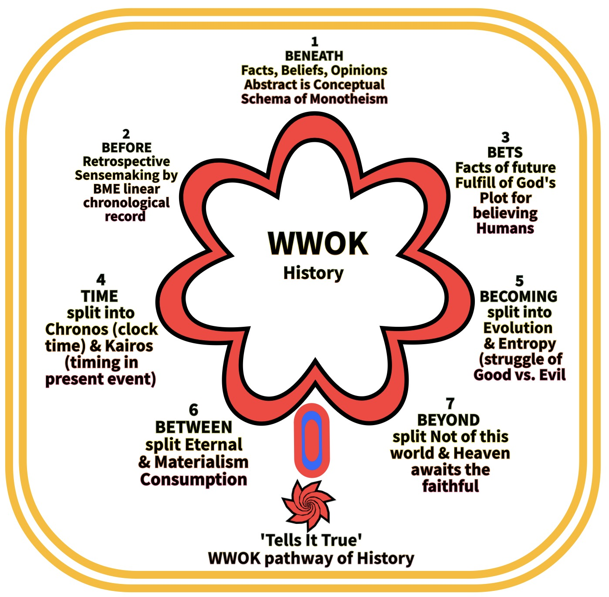

Slide 11
Braided River

Slide 12
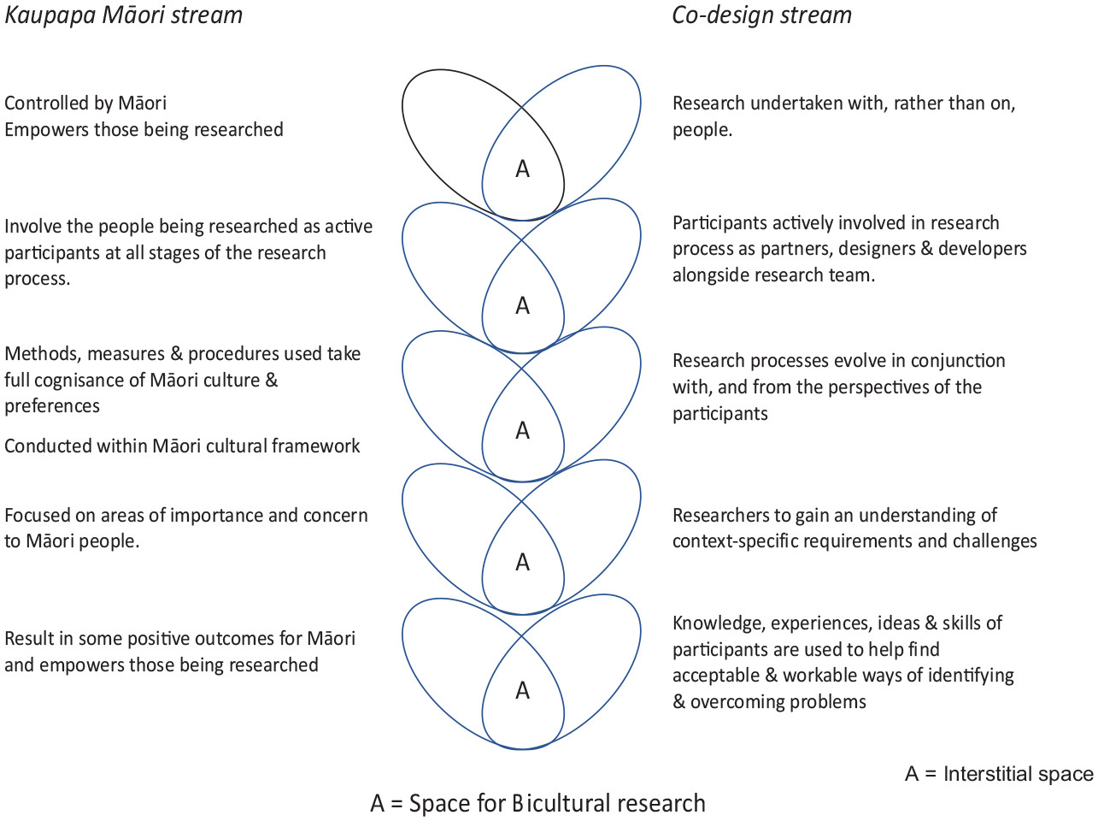
Māori Solution to WWOK (Kaupapa) and IWOK (Māori)

Slide 13
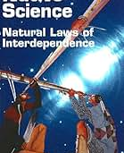
Leroy Little Bear

Slide 14
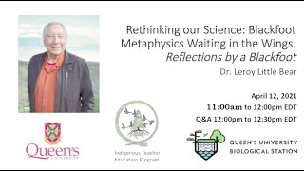
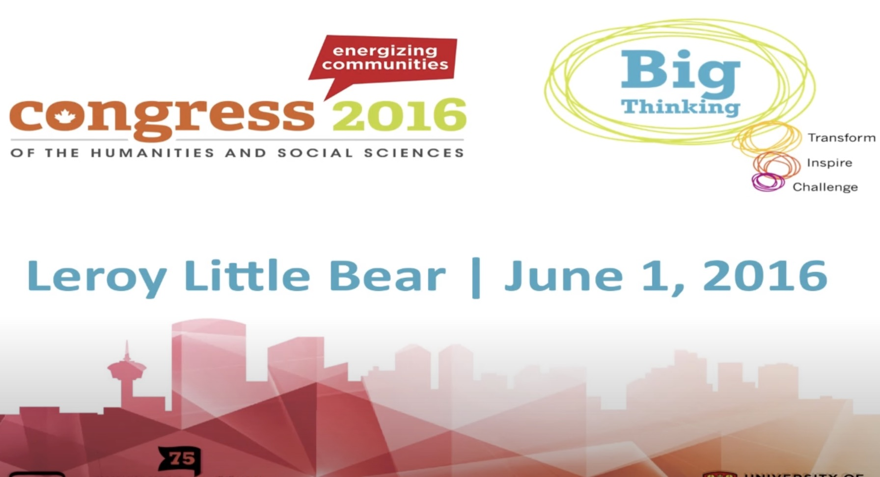
Source material Leroy Little Bear Black Foot Metaphysics
Bear, Leroy Little (2021). Rethinking our science; Blackfoot Metaphysis Waiting in the Wings: Reflections by a Blackfoot https://www.youtube.com/watch?v=YWH6RTgLRaU
Bear, Leroy Little (2016, June). Big Thinking—Leroy Little Bear: Blackfoot Metaphysics ‘Waiting in the Wings,’. In Congress of the Humanities and Social Sciences, uploaded June (Vol. 1); University of Calgary. Retrieved from http://congress2016. ca/program/events/little-bear [no longer online] short summary at https://ucalgary.ca/news/first-nations-thought-leader-says-old-way-thinking-new-way-forward & excellent Youtube https://www.youtube.com/watch?v=o_txPA8CiA4
Bear, Leroy Little (2016, December). Quantum Physics and Storytelling. Quantum Storytelling Conference keynote. New Mexico State University Las Cruces New Mexico. Video by Ed Breeding
https://www.youtube.com/watch?v=YWH6RTgLRaU
https://www.youtube.com/watch?v=o_txPA8CiA4

Slide 15
What is Quantum Storytelling?
When Leroy Little Bear presented to annual 2016 Quantum Storytelling Conference these are the takeaways
Next are my contrasts of quantum physics and quantum storytelling

Slide 16
What do I mean by Metaphysics?
The ways of thinking embedded in us
result of Age of Reason
Who Am I?
What Am I Doing?
-Leroy Little Bear

Slide 17
Blackfoot Metaphysics
Blackfoot Metaphysics & Quantum Physics have larger areas of overlap
Universities are the present gatekeepers of knowledge
Just like the Church & Monarchs used to be
Are these gatekeeping approaches out of date?
Left brain metaphysics increasingly leads universities to being Tech school, instead of - The Pursuit of Knowledge
Let’s Stop and Reflect
Blackfoot Metaphysics is Waiting in the Wings
-Leroy Little Bear

Slide 18
Blackfoot Metaphysics
But Where is Western Metaphysics Taking Us?
We as homo sapiens, are we better off as a result of it?
Is it really advancing the reasons for our existence?
(If we ever stop and think about it)
Is our current metaphysics not another passing phase?
Maybe there are other metaphysics that we should take a look at.
-Leroy Little Bear

Slide 19
Energy Waves
Everything in Creations consists of energy waves
Energy Waves are the Spirit
-Leroy Little Bear

Slide 20
Everything is Animate
Everything in Creation is Animate and imbued with Spirit
-Leroy Little Bear

Slide 21
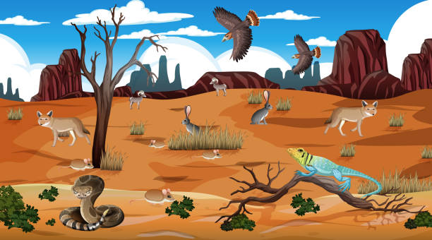
Everything is Related
All My Relations
-Leroy Little Bear

Slide 22
RENEWAL
Reality Requires Renewal for Continuing Existence
- Leroy Little Bear

Slide 23
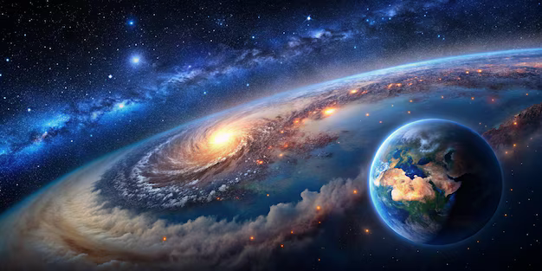
Space/place
Indian Thought is About Space Referencing
-Leroy Little Bear

Slide 24
[Blackfoot] Language is process/action
Indian Language is Process Oriented
-Leroy Little Bear

Slide 25
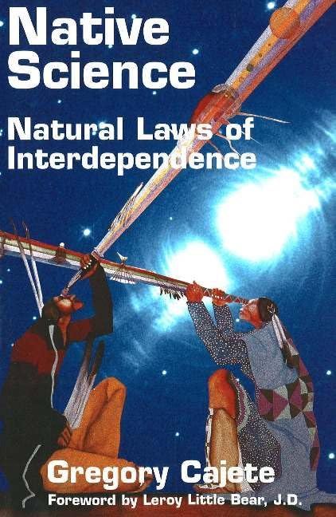
Western & Native Science
Western Science is largely aimed at exploration
Native Science is aimed at Sustainability
We exist in a very narrow gap of ideal conditions
We need to maintain those conditions if we are to be around as long as the fish has.
But have we ever asked the fish what his secret is?
-Leroy Little Bear

Slide 26
Some observations
Higgs Particle/field
Native Science would say Transformation/spirit
Grand Unified Theory
will never happen – cannot reproduce energy level, the big bang
Superstring Theory, maybe
It is about flux, process & action
Leroy Little Bear

Slide 27
 | Quantum Physics | Native Science
Consciousness | Affects reality | Affects Reality
Matter/objects | Space curvature | Description
Time | Space/Time continuum | Just is
Matter | Particle/wave duality | Wave
Reality | No deep reality | Subjective
Cause/effect | Paradox | All cause/effect
Perspective | Reductionist | Wholistic
Method | Experiment/proof | Observation
Knowledge | Cumulative | Renewal
Language | Binary/math | Process
-Leroy Little Bear

Slide 28
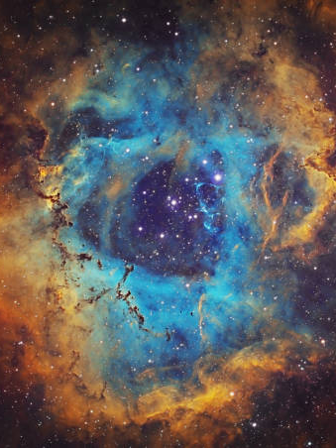
Transition to Heidegger
Most adventures in metaphysics attempt to fix upon a few basic concepts and, using these abstract ideas, explain the remainder of the experiential world in those terms.
-Vine Deloria

Slide 29
Heidegger Metaphysics
Here, I want to develop my own notion of ‘tells it true” (https://tellsittrue.com).
The key question: raised by Heidegger: Why are there essents rather than nothing?” (p. 1)
[essents are defined as existents]
Truth is defined as “in essence of Being” (86-7) “To be able to stand in the Truth” (p. 17). “Being-there into the clearing of being” (17), “grounded in letting-be” (17), and “truth is the manifestness of the essent” (17).
The main process of what I call ‘tells it true’ is in Heidegger term, unconcealment.
We encounter appearance that emerges from concealment, and can misinterpret, this word “truth”, when what Heidegger aims for ”Truth is unconcealment” (87).
“Truth is inherent in the essence of being” (87).
Tells it Ture, for me, is the truth that comes to light, and is “coming-on-the-scene” (87), out of concealment.

Slide 30
Tells it Ture is not social media
Truth is not acquired from newspaper, radio in Heidegger’s day, or social media platforms in our day (87): Facebook, Twitter, Google, YouTube, and so on.
It is not the appearance of an opinion. “But what covers over and conceals what is the essent untruth, i.e., in unconcealment” (87).
Tells it true is an unconcealment.
Tells it true” is not an appearance, view, or opinion, it is always an unconcealment.
In Being and Appearing, “that appearance is historical” (89).
Respecting what is already there, historical: “Truth in the sense of unconcealment and untruth as concealment” (90).
My field of Storytelling enters the realm of (idle) talk and statements, opinions, views, and so on.
This is not what Larsen, Bruun, & Boje call ‘true storytelling.’

Slide 31
Heidegger and Correctness
In Heidegger’s concern for correctness taking over the essent, there is a relation between physis and logos, emerging-into-unconcealment, and the transformation of physis and logos into just some idea … anorder statement.
Storytelling has incurred this historical change, which constituted a transformation of the essence of truth from unconcealment to correctness (159).
For example, facts as correct or not correct, true or false is a misinterpretation of Tells it true. Unconcealment is a space created for the appearance of the essent (159).

Slide 32
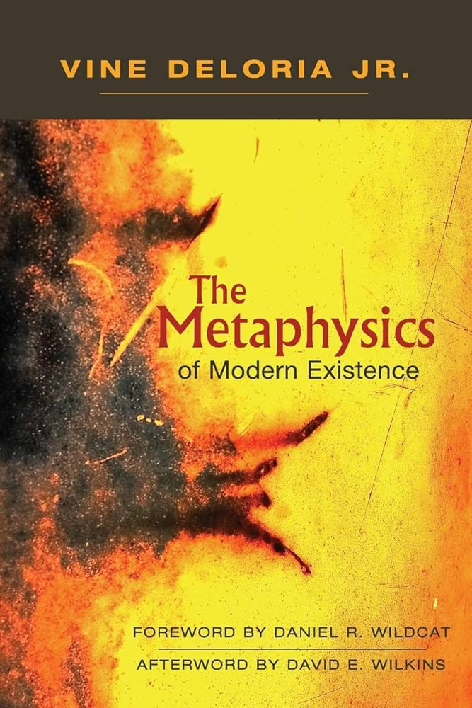
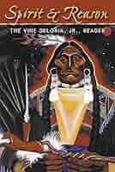
Vine deloria Jr.

Slide 33
Where Heidegger & Deloria overlap
No person can claim to have pierced the veil of reality and properly articulated what he or she has found
-Deloria Ch 1 The Metaphysics of Modern Existence

Slide 34
What Deloria means by metaphysics
A Quest - Search for structure and meaning of reality
-Deloria Ch 1 The Metaphysics of Modern Existence

Slide 35
Tells it True is not theory
I soon came to realize that theories are not accepted because they are true
-Deloria Ch 1 The Metaphysics of Modern Existence

Slide 36
Deloria’s Metaphysics severely critiqued by Ward Churchill
Ward Churchill pretended to be American Indian. His book review”
“It is not that the material contained in Metaphysics is invalid or poorly presented.
It is that the material is not to the point. The problem is one of the context of presentation. It is clearly impossible to develop a contemporary metaphysics based upon the synthesis of existing thought / material while failing to incorporate conclusions drawn from the bulk of European philosophy proper.
This is most particularly true in that Deloria himself opted to treat European thought as his primary format. Yet it is precisely the bulk of European philosophy which is omitted from consideration in this book. It is time to be specific (Chucrchill source https://escholarship.org/uc/item/74z1k3j6)

Slide 37
Churchill review of Deloria’s metaphysics book
There are others. Kierkegaard's Christianity and its relationship to Niels Bohr might have proven an interesting area of exploration. Heidigger, Neitsche, Wittgenstein and Russell are all to obviously important to have been ignored in any examination attempting to synthesize a metaphysics. Husser!'s fusion of biology (the physiology of perception) with phenomonology would have led the examiner directly to Merleau-Ponty and Sartre and, through Sartre's inversion of existentialism, to Marx in the form of Althusser and Foucault. The work of Breton, Artaud, Chomsky, Lenin, Gramsci, Lukacs and others might have been at least acknowledged (source https://escholarship.org/uc/item/74z1k3j6).

Slide 38
American Indian Metaphysics
For many centuries whites scorned the knowledge of American Indians, regarding whatever the people said as gross, savage super­stition and insisting that their own view of the world, a complex mixture of folklore, religious doctrine, and Greek natural sciences, was the highest intellectual achievement of our species
-Deloria Chap 1: American Indian Metaphysics

Slide 39
American Indian MEtaphysics
… we should focus our attention on the metaphysics possessed by most American Indian tribes and derive from this central perspective the infor­mation and beliefs that naturally flowed from it.
-Deloria Chap 1: American Indian Metaphysics

Slide 40
Everything is related
The best description of Indian metaphysics was the realization that the world, and all its possible experiences, constituted a social reality, a fabric of life in which everything had the possibility of intimate knowing relationships because, ultimately, everything was related.
-Deloria Chap 1: American Indian Metaphysics

Slide 41
Tells it true – suspended judgment
Most adventures in metaphysics attempt to fix upon a few basic concepts and, using these abstract ideas, explain the remainder of the experiential world in those terms. Indians use a peculiar way of maintaining a metaphysical stance that can best be termed as "sus­pended judgment.”
-Deloria Chap 1: American Indian Metaphysics

Slide 42
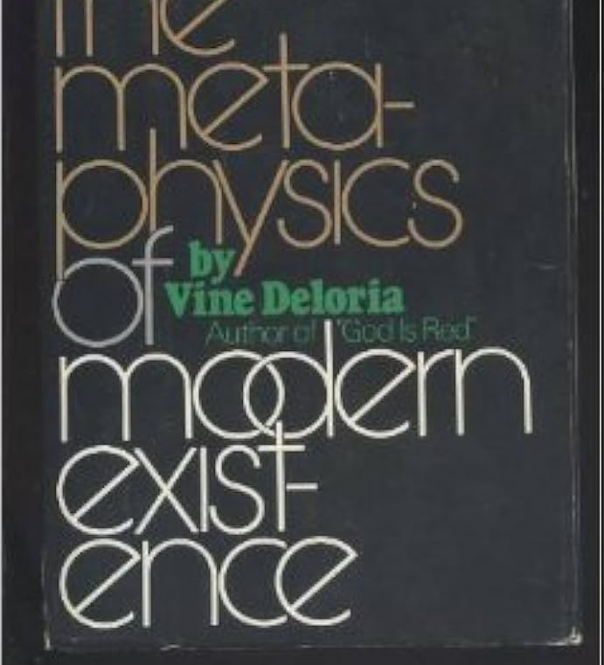
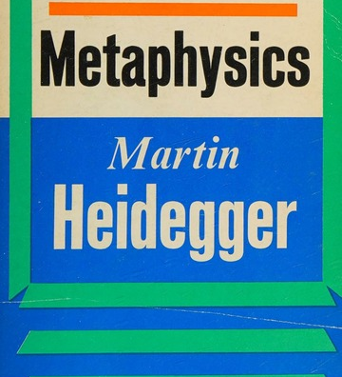
Key points
Leroy little Bear’s Blackfoot Metaphysics is a kin to Devine Deloria’s book: Metaphysics of Modern Existence (1979).
Both these indigenous metaphysics are about process languages and for Heidegger the process is that of unconcelment
Little Bear and Deloria present an alternative to Martin Heidegger’s book: Introduction to Metaphysics (1944).
Little Bear, Deloria, & Heidegger critique modern existence, including technology
Big difference: Little Bear & Deloria focus is space/place/land, while Heidegger focus is Being and Time (getting out from under Chronological time).
Big difference: Little Bear & Deloria more focused on Spiritual Energy of place, the spirituality of plants, animals, mountains, water, etc. Heidegger later essay focus is ‘what is the essence of Being and Truth.

Slide 43
Key points
6. Metaphysics of euro & north American white-society, -culture, -education, -science… are ever-appropriating Indigenous Metaphysics, but
7. Indigenous metaphysis is not the solution to White metaphysics
8. Heidegger metaphysics is not nature-focused enough to resolve climate problems, too left-brained, & not space-place-land-enough to sustain homo sapien life in age of 6th extinction.
9. Heidegger reclaims pre-Socratic Greek language & ideas (Heraclitus) to critique modern existence & ways of Being.
10. Leroy Little Bear brings a more focused contrast of Quantum Physics and Native Science, as well as Indigenous Metaphysics.

Slide 44
Key points
11. USA is too individualistic to engage in conversational storytelling processes.
12. USA is divided into political party us versus them echo chambers.
13. The new technologies of information systems have more critique by Deloria & Little Bear, than by Heidegger.
14. Facebook, Google, Twitter social media algorithms and chatbots focus on user engagement time, & hate, revenge, ridicule, blame, & shaming the other get more social media time and space (see 2024 book by Harari).
15. Harari makes point that it is less costly for social media to spread conspiracy theories, fantasy, fake news than it is to do research into what’s true. What’s true is more expensive, more complicated, and not so simple as fake.
16. Harari says we are witnessing the end of democracy in many countries, as they switch to dictatorships because people have lost the ability & courage to engage in conversations with those who they disagree with. Dictators just dictate what’s true, and jail dissenters or worse.
17. Heidegger is not communicating in accessible language or storytelling, & is accused here of being anti-narrative, not process oriented metaphysics.

Slide 45
Braided River

Slide 46
More info
Annual December Quantum Storytelling Conference –
Quantum-Storytelling.com
Tellsittrue.com
TrueSTORYTELLING.org
davidboje@gmail.com
Antenarrative.com

